Slide 1
SQL MINI PROJECT
Ginamarie Mastrorilli
7/8/2024

Slide 2
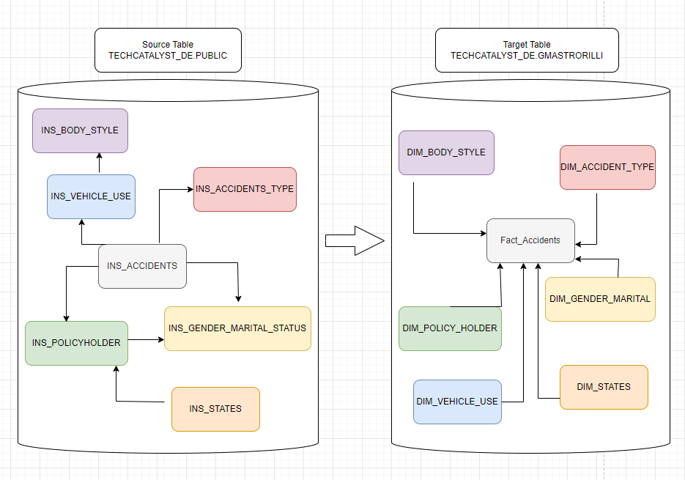
Reference Architecture Diagram
* Visualization only shows tables used

Slide 3
Overall Process
1. Source Table Data Exploration
Challenges:
Ensuring the correct table & column were used in ETL
Ex: INS_VEHICLE_USE_CODE was blank → VEHICLE_ID instead of VEHICLE_USE
Understanding End Result Before Analysis
Tried to validate before creating Fact_Accident table
2. Create Target Tables
3. Perform ETL
4. Data Analysis

Slide 4
Data Analysis
9,907
Total Claims
Top 3 States
Based on Highest Number of Claims
# of Claims | State
1,037 | Dist. Of Columbia
762 | California
434 | Texas
10,000
Policy Holders
Total Claim Amount
Per Accident Type
$18,446,291 | Vandalism
$9,640382 | Collision- Vehicle Physical Damage
$9,530,580 | Theft
$9,345,399 | Bodily Injury
$9,205,913 | Fire
$8,984,016 | Collision- Property Damage
$65,152,581
Total Claim Amount
$6,576.42
Avg Claim Amount

Slide 5
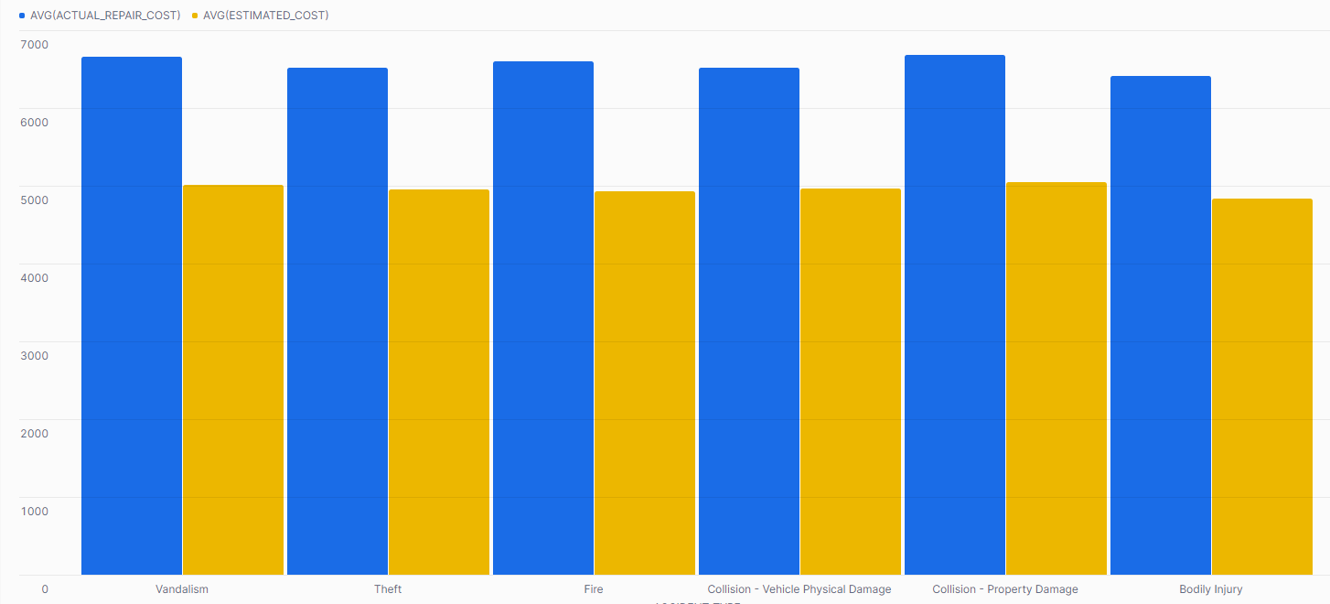
Data Analysis
Avg Estimated Cost & Avg Actual Repair Cost
by Accident Type
North Dakota has the highest discrepancy between actual and estimated repair cost with an average of $5,893.

